Slide 1
Online Atlas
Cómo identificar áreas idóneas para invertir en proyectos renovables

Slide 2






DNV GL
12,000
employees
150+
years
100+
countries
100,000+
customers
5% R&D
of annual revenue
MARITIME
OIL & GAS
ENERGY
BUSINESS ASSURANCE
DIGITAL SOLUTIONS
Technology & Research
Global Shared Services
Notes:
Our global reach and density of offices around the world is another factor that enables us to take a broader view. Our 13,000 employees are operating in more than 100 countries (we have 350 offices in 90 countries) and we pride ourselves of having the same high standards where ever you meet us around the world.

Slide 3


Online Atlas
Renewable Developer: I need help to explore the best places to develop new projects
Investor: I need support to review and screen investment opportunities
Where are the best resource conditions?
Best grid connection?
Might environmental or social restrictions affect the project?
Is there any risk of severe hazards that could compromise the project return?
And what if I adjust my criteria, can I get updated results?
Notes:
Esta herramienta surge para apoyar a empresas que quieren desarrollar nuevos proyectos de generación renovable
y a inversores que tienen que evaluar múltples opciones de inversión
En ambos casos necesitan poder identificar dónde están las condiciones que mejor se ajustan a sus criterios
De forma sencilla, interactiva, ágil y configurable

Slide 4

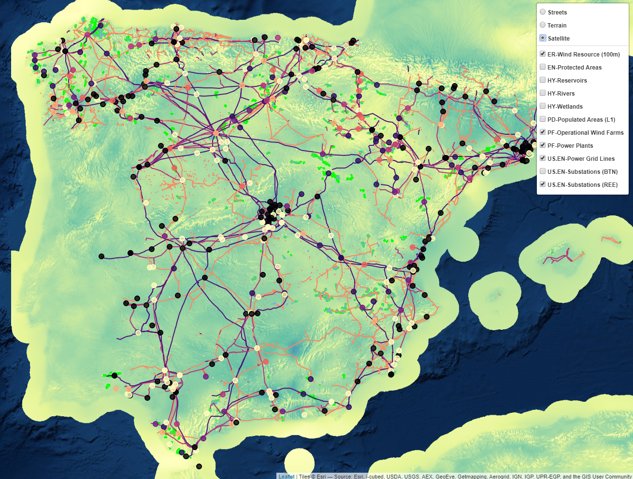
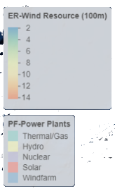
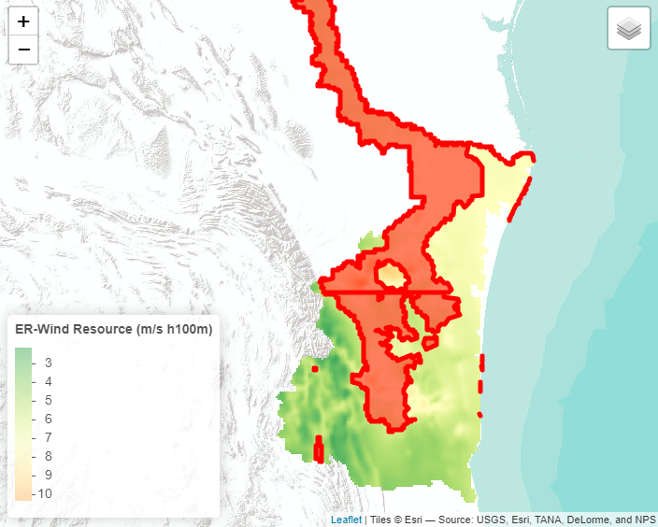


Online Atlas Main Features
Web Application, Map based
Visualize and Explore using your browser
Exhaustive GIS Data Catalog
+ Wind & Solar resource layers
+ Key GIS datasets
Protected areas, Natural hazards, Hydrology, Terrain models, Power Grid…
Multicriteria Filtering
Define and apply ad hoc restrictions
Discover the suitable areas on the fly
Notes:
Online Atlas is a web application especially designed to assist our clients in the identification of risks, to support their investment decisions in wind and solar assets.
The Online Atlas combines wind and solar resource information layers with an exhaustive catalogue of relevant geographical features affecting a project location. This includes information about protected areas, natural hazard zones, hydrology, terrain models, and other valuable datasets
Besides, the Online Atlas also allows end users to query the system. Users can choose between a wide variety of filters on the available layers, setting up and composing complex conditions in a very intuitive way. The Online Atlas enables the user to easily discover, analyze and narrow down suitable locations on the fly based on her own criteria
The goal is to offer a powerful tool, yet very easy to use even for GIS-untrained users, bringing all the key functionalities together in a single one-stop web app. And backed by the experience of DNV GL on assessing risks for renewables assets

Slide 5
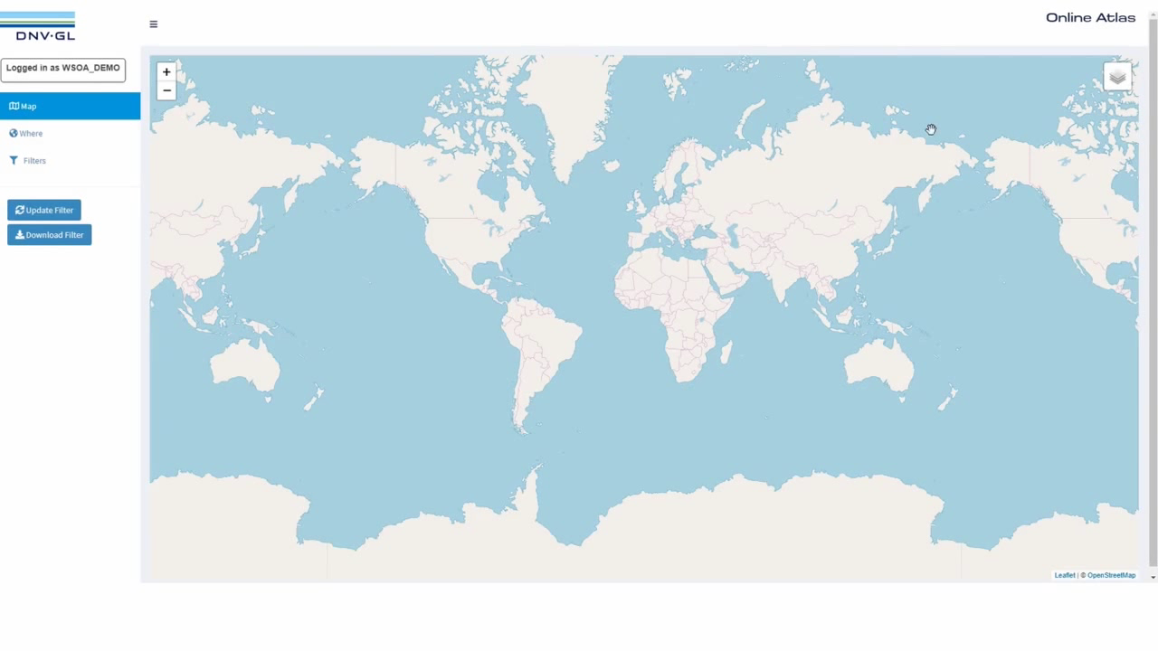

Slide 6
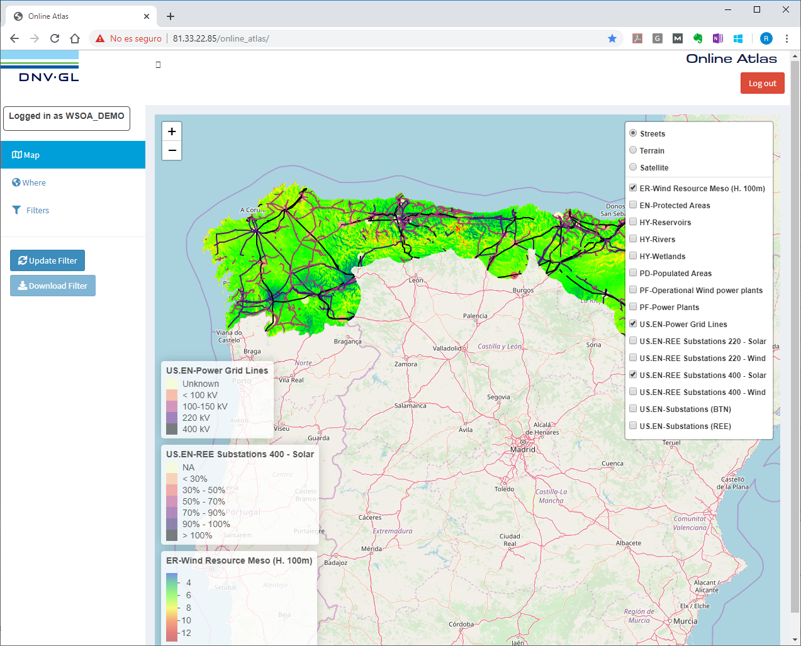
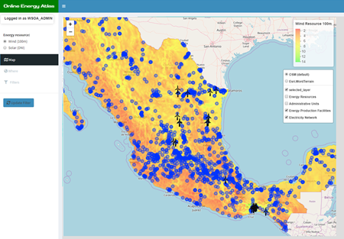
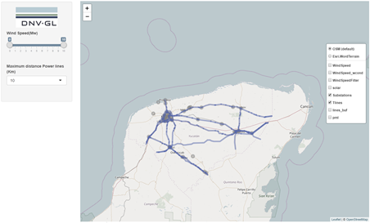
Why R? Why Shiny?
Already using R + Shiny for internal analysis and basic tools
Data-centric
Visual and interactive
Agile app lifecycle
Fully functional App
Demo App
with basic features
App Mock-up
library(shiny)
library(shinyjs)
library(shinyauthr)
library(shinydashboard)
library(shinycssloaders)

Slide 7






Architecture
On-Prem Shiny Server
Online Atlas Shiny App
App Controller
Data Access
Filters
GUI
Async Task
(Future/Promise)
Widgets
Map
Batch Processing
www
Extract & Prepare
Spatial Analysis
Voronoi Tesellation
Dem to Slope class
GIS harmonization
Statistics & Profiling
Notes:
automated batch and offline processes!
gather and preprocess data
statistics and profiling
spatial analysis and calculation
Voronoi tessellation
DEM to slope classification
Multiple GIS data sources consolidation harmonisation

Slide 8
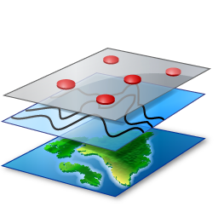
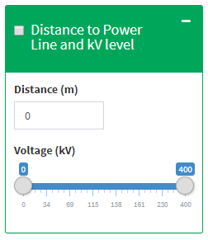
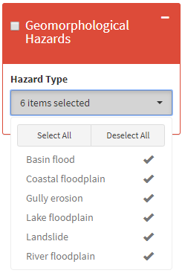
Filter Engine
Filter Template
Filter Type = {spatial, by attib,...}
Combine Type = {Include, Exclude}
Layer Id = {...}
Layer Attrib Id = {...}
Partial Filter Fun Template
Partial Filter Function
Feature filtering
Spatial buffering
Exclude Area
...
∑
Filter Composition
Config
Widget Template
Spatial Algebra
Include Area
Callback
library(raster)
library(rgdal)
library(sf)
library(rgeos)
library(RPostgreSQL)
library(shinyWidgets)
+ Customization, Extensions
Notes:
Configurable Filter engine based on templates
For each layer we can define as many filters as needed
Each filter class -> Filtering widget template + Filter function template + Filtering callback template
Different filter Classes
Inclusive vs Exclusive
By Attrib Value / Distance / Distance + attr. range / Distance + cat. single choice / Distance + cat. multiple choice
Filter calculation
Spatial buffering and feature filtering
Filter composition
- Spatial algebra operators

Slide 9
Responsiveness. Asynchronous Processes
Wide catalog of large datasets (GIS, tabular)
Avoid app from stalling/blocking when performing heavy tasks with large datasets
Loading & Rendering
Complex computations on the fly: Filters
Massive use of Futures and Promises
Asynchronous execution, lazy evaluation, promises chaining
Integration with Shiny: event-driven, reactive values
library(promises)
library(future)
plan(multiprocess)
user_data <- reactiveValues()
user_data$geo_layers_promise <- future({load_layers(...)})
then(user_data$geo_layers_promise,
onFulfilled = function(actual_geo_layers) {
render(actual_geo_layers)
})

Slide 10
Performance boosting
library(RPostgreSQL)
require(pool)
dbcon <- get_db_con_pool(dsn)
geo_layers_promise <- future({load_layers(dbcon)})
DB pooling
Pool of preset connections to the database
Fetch idle connection from pool → Release
Special care with Future operations
Connection from pool not preserving state when passed to “promised” function
Different thread!
Need to pass DSN and let “promised” function get itself a new connection
Filter precalculation
Offline processes to create precalculated results
Spatial calculus & algebra

Slide 11

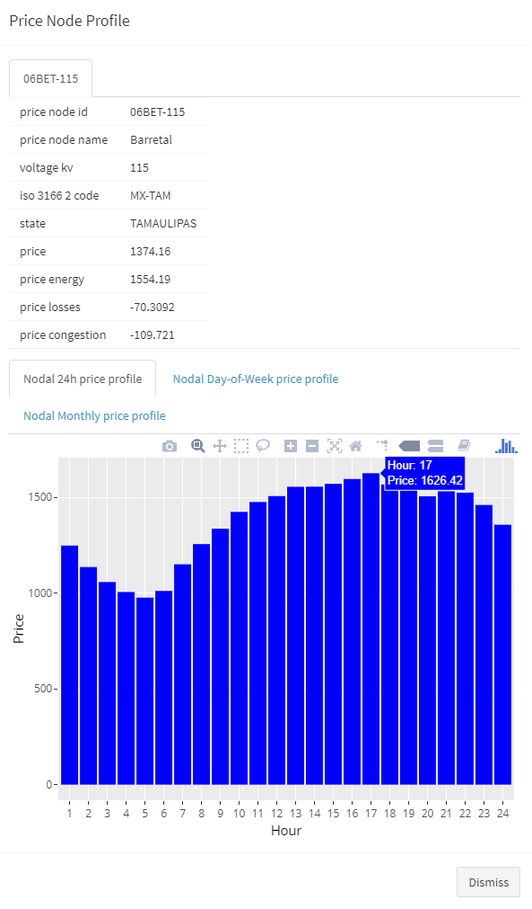
Visualization
Maps
Leaflet
Configurable styles per layer
Issues
Integration of Leaflet JS plugins
Dealing with hierarchical data (toggling visualization)
Multi-styled visualization (same layer, different attributes)
Data
Plotly
Tabular, Charts
library(leaflet)
library(leaflet.extras)

Slide 12
Thanks!
Ruben Moreno
Ruben.Moreno.Ruiz@dnvgl.com
+34 976 43 51 55

